Slide 1
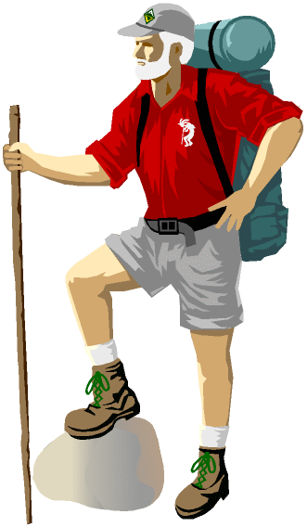
Hierarchical Clustering and Random Forests to Identify Hotel Rank
Kyle Henke
Manish Bhattaral
Kellin Rumsey
Zach Stuart

Slide 2
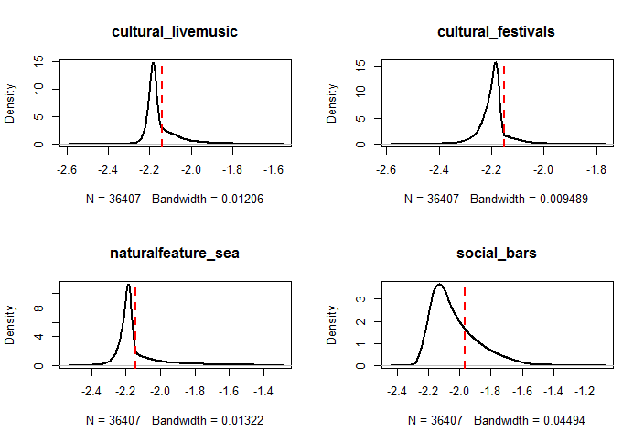
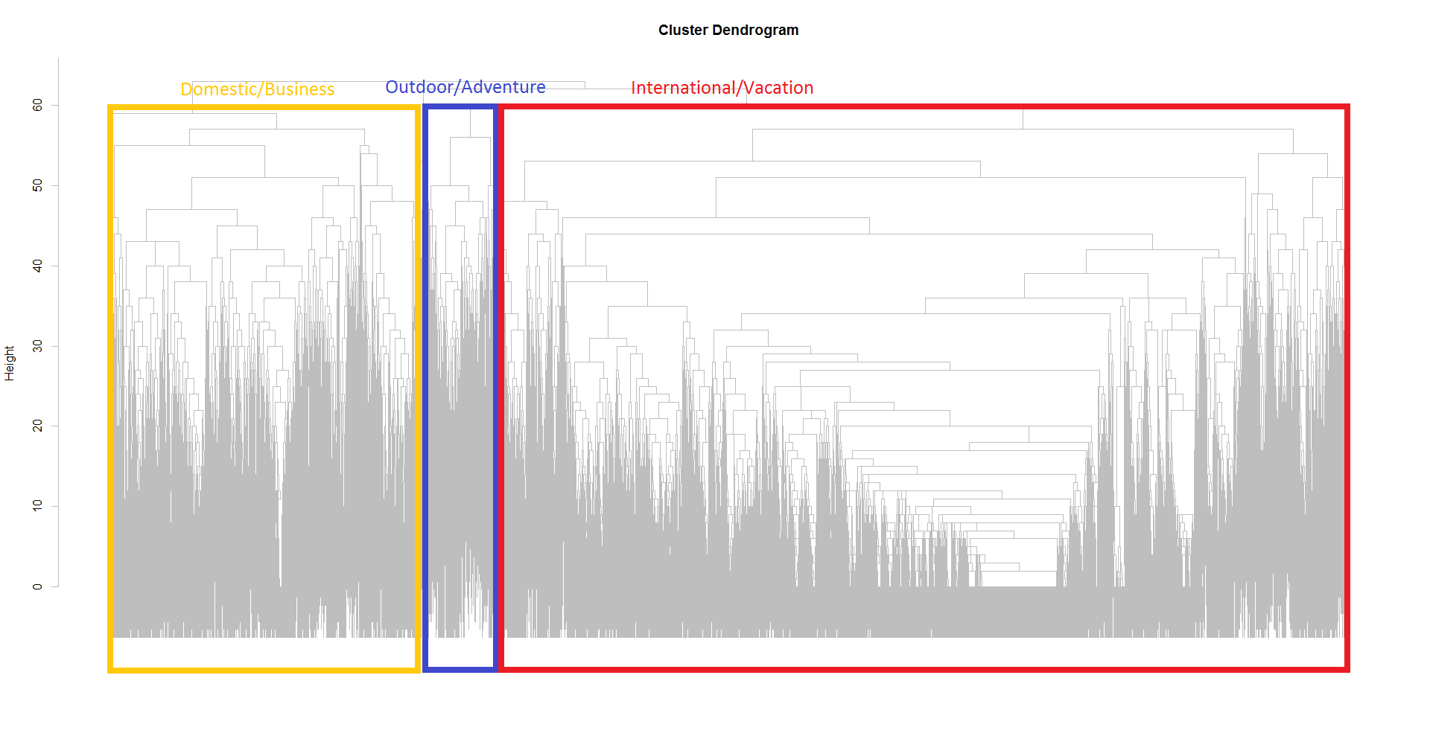
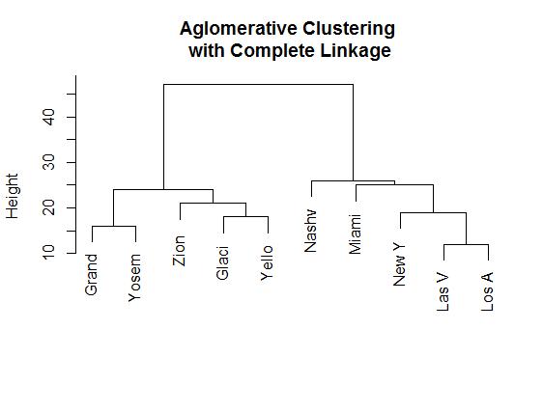
Hierarchical Clustering – Finding Similar Destinations
srch_destination_id | srch_name | srch_type | srch_lat | srch_lon | popular_*
8524 | “Albuquerque, NM” | 557 | 35.08684 | -106.6726
Probability of a recommendation on log-scale
New York
Las Vegas
ABQ
Nashville
Sports, Business,
Shopping, Culture
Glacier Nation Park
Zion National Park
Grand Canyon NP
Hiking, Nature, Mountain River
Bahamas
Honolulu
Miami
Tokyo
Paris
Beach, Spa,
Golf, Luxury

Slide 3
Random Forests – Finding Attractive Hotel Attributes
srch_destination_id | is_booking | hotel_id | prop_is_branded | prop_starrating | distance_band | hist_price_band
8524 | 1 | 557 | 1 | 3 | VC | L
TRAINING THE RANDOM FOREST
Take a random subset
Take a random subset from similar cluster
RANKING HOTELS WITHIN A REGION
For each hotel in a destination, use RF to estimate booking probability.
Compare results to actual data.
IMPROVING THE METHOD
Filter clustering by search type
Attribute selection in clustering.
SVM
Zion National Park
Predicted Booking Probability (37 hotels)
Hotel Ranking | Random Subset | Cluster Subset | Actual Bookings
1st | 11.35% | 26.85% | 14.56%
2nd | 11.35% | 21.19% | 11.26%
3rd | 11.35% | 10.83% | 9.89%
4th | 11.35% | 10.36% | 7.14%
5th | 11.35% | 5.49% | 6.86%

